Slide 1
GWLF Teaching
2013

Slide 2


S
$Q_{t}$
𝐐_𝐭
CN
Input: $P_{t}$
Input: 𝐏_𝐭
The reservoir inflow
${PC}_{t}$
〖𝑷𝑪〗_𝐭
$S_{t}$
𝐒_𝐭
${ET}_{t}$
〖𝐄𝐓〗_𝐭
Input: $T_{t},H,C$
Input: 𝑻_𝐭,𝑯,𝑪
$G_{t}$
𝑮_𝐭
Unsaturated zone
saturated zone
$$G_{t}=r∙S_{t}$$
$$Confined aquifer$$

Slide 3
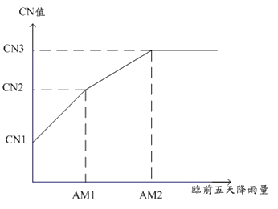
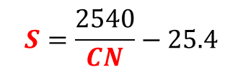



Input: $P_{t}$
CN
S
$Q_{t}$
The reservoir inflow
${PC}_{t}$
〖𝑷𝑪〗_𝐭
$S_{t}$
𝐒_𝐭
${ET}_{t}$
〖𝐄𝐓〗_𝐭
Input: $T_{t},H,C$
Input: 𝑻_𝐭,𝑯,𝑪
$G_{t}$
𝑮_𝐭
$$S=\frac{2540}{CN}−25.4$$
CN
Precipitation
P₅
Time
臨前五天降雨 | AM1 | AM2
休耕期 | 1.27cm | 2.79cm
生長期 | 3.56cm | 5.33cm
$$if P<0.2S,Q=0$$

Slide 4
S
$Q_{t}$
𝐐_𝐭
CN
Input: $P_{t}$
Input: 𝐏_𝐭
The reservoir inflow
${PC}_{t}$
〖𝑷𝑪〗_𝐭
$S_{t}$
𝐒_𝐭
${ET}_{t}$
〖𝐄𝐓〗_𝐭
Input: $T_{t},H,C$
Input: 𝑻_𝐭,𝑯,𝑪
$G_{t}$
𝑮_𝐭
$$G_{t}=r∙S_{t}$$

Slide 5
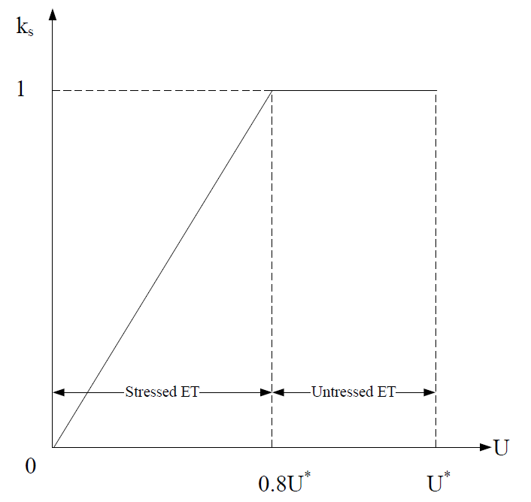


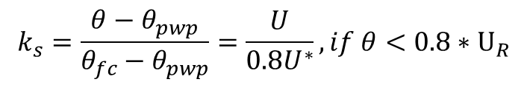





S
$Q_{t}$
𝐐_𝐭
CN
Input: $P_{t}$
Input: 𝐏_𝐭
The reservoir inflow
Input: $T_{t},H,C$
${ET}_{t}$
${PC}_{t}$
$S_{t}$
$G_{t}$
$$G_{t}=r∙S_{t}$$
$$k_{s}=\frac{θ−θ_{pwp}}{θ_{fc}−θ_{pwp}}=\frac{U}{0.8U^{∗}},if θ<0.8∗U_{R}$$
H.csv:日照時數表
C.csv:折減係數表
$$if P>1.0,ET=0$$

Slide 6
S
$Q_{t}$
𝐐_𝐭
CN
Input: $P_{t}$
Input: 𝐏_𝐭
The reservoir inflow
${PC}_{t}$
〖𝑷𝑪〗_𝐭
$S_{t}$
𝐒_𝐭
${ET}_{t}$
〖𝐄𝐓〗_𝐭
Input: $T_{t},H,C$
Input: 𝑻_𝐭,𝑯,𝑪
$G_{t}$
𝑮_𝐭
$$G_{t}=r∙S_{t}$$

Slide 7
Input file
Input.txt
Initial.txt
H.csv
含台灣四區的日平均日照時數，逐月改變在蒸發散計算中需要用到
C.csv
含台灣四區的蒸發散係數與土地利用有關，會隨集水區土地利用改變
-P.txt -T.txt

Slide 8
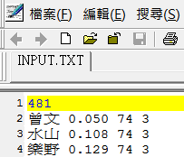
Input.txt
area(km²)
分區狀況依台灣地區北中南東四區區分依續為1 2 3 4
站名
CN2
權重

Slide 9
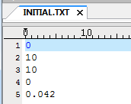
Initial.txt
The initial flow of groundwater discharge
The initial moisture content of
the unsaturated zone
Root layer content
The initial moisture content
of the saturated layer
Recession Number

Slide 10
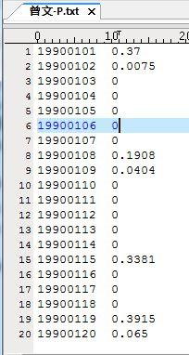
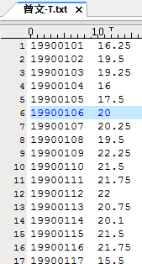
-P.txt -T.txt
Ex
單位:cm
單位: ℃

Slide 11
Output file
CN(Each station daily CN value)
ET(Evapotranspiration value of each station)
GT(Groundwater discharge)
O(discharge)
P(Precipitation)
P5(Earlier five day Precipitation)
T(temperature)
UT(Unsaturated zone)
QS(runoff)
PC(Seepage)
ST(saturated zone)
RESLUT(The simulation results, including monthly flow)
RESULT T-D(Daily simulation results, unit CM)
Temp(Temporary files)

Slide 12
水庫參數(The reservoir parameters)
水庫集水區 | area(km²) | Elevation(m) | CN2 | Recession Number
Shimen Reservoir | 763.4 | 1403.1 | 64 | 0.073
Fei-Tsui Reservoir | 300.5 | 473.9 | 74 | 0.052
Tseng Wen reservoir | 481.0 | 961.0 | 74 | 0.042
Weather Stations | Mean of Elevation (m)
台北(Taipei) | 5.3
台南(Tainan) | 13.8
Temperature correction :
Watershed temperature=
Temperature of near Weather Stations
- (The reservoir Elevation-Weather Stations
Elevation) * 0.0065

Slide 13
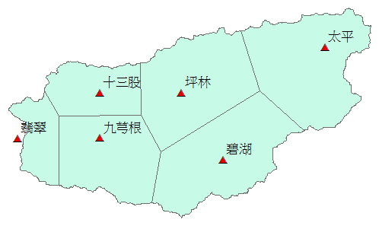
Fei-Tsui
站名 | 面積(m²)
九芎根 | 50618948.95
坪林 | 63738904.132
太平 | 69293984.614
翡翠 | 20098081.732
十三股 | 30782898.237
碧湖 | 66000422.336

Slide 14
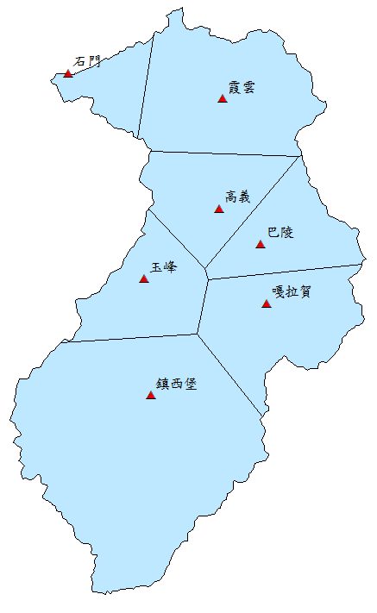
Shimen
站名 | 面積(m²)
巴陵 | 64610097.059
高義 | 68953075.05
鎮西堡 | 293343959.615
霞雲 | 129727669.213
玉峰 | 68925827.132
嘎拉賀 | 97840855.608
石門 | 32522865.814

Slide 15
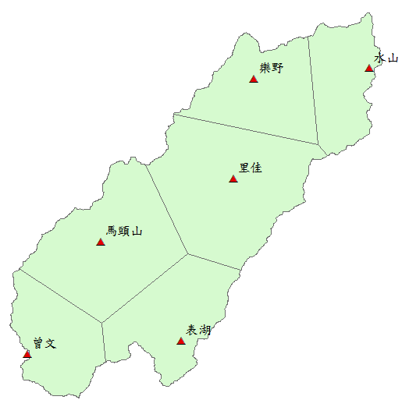
Tseng Wen
站名 | 面積(m²)
里佳 | 123438543.477
水山 | 53006082.359
馬頭山 | 106119003.144
曾文 | 57060736.49
樂野 | 69448139.276
表湖 | 71134695.254

Slide 16
Remarks
如何將逕流量(CMS)轉換為逕流深度(CM)

